Slide 1
RECOMMENDATION SYSTEM

Slide 2
RECOMMENDATION SYSTEM
GUIDED BY : PRESENTED BY:
Mrs. NEHA GUPTA MAHESH RENKUNTLA
ADITYA RAO
NIKHIL HOSAMANI
SOBEEYA HAMDAANI
PRAJWAL TIPALE
ASHISH SINHA

Slide 3
INTRODUCTION & OBJECTIVE
A recommendation system broadly recommends items to the user best suited to their tastes and traits. It uses the user’s previous data and other users' data to give new recommendations.
Let's look at the recommendation models we have tried…
The main objective is to create a machine learning model to recommend relevant books to users based on popularity and user interests.

Slide 4
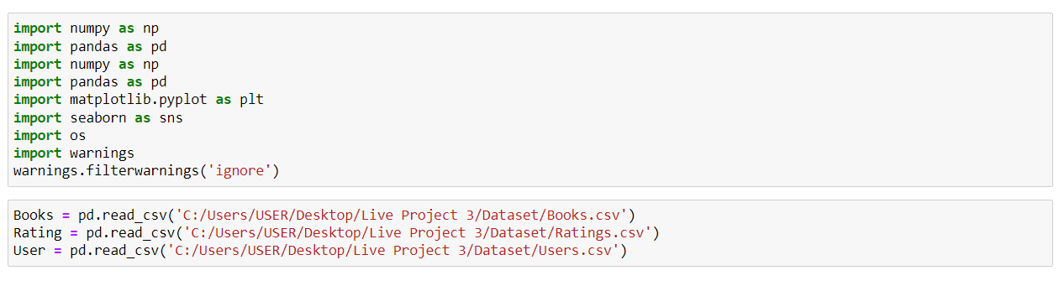
DATASET:
The dataset we have used in this work is the Book-Crossing Dataset that comprises three tables: -
Books- It has 8 columns; ISBN, Book title, Book author, Year of publication, Publisher, and three columns for Book cover Image URLs representing three different versions (small, medium, and large).
Users- Contains the user’s information. It consists of 3 columns User-ID, Location, and age.
Ratings- Contains the information on ratings of the books. It consists of 3 columns User-ID, ISBN, and Book Rating.
So, start with we must Import all the required libraries and input dataset :

Slide 5
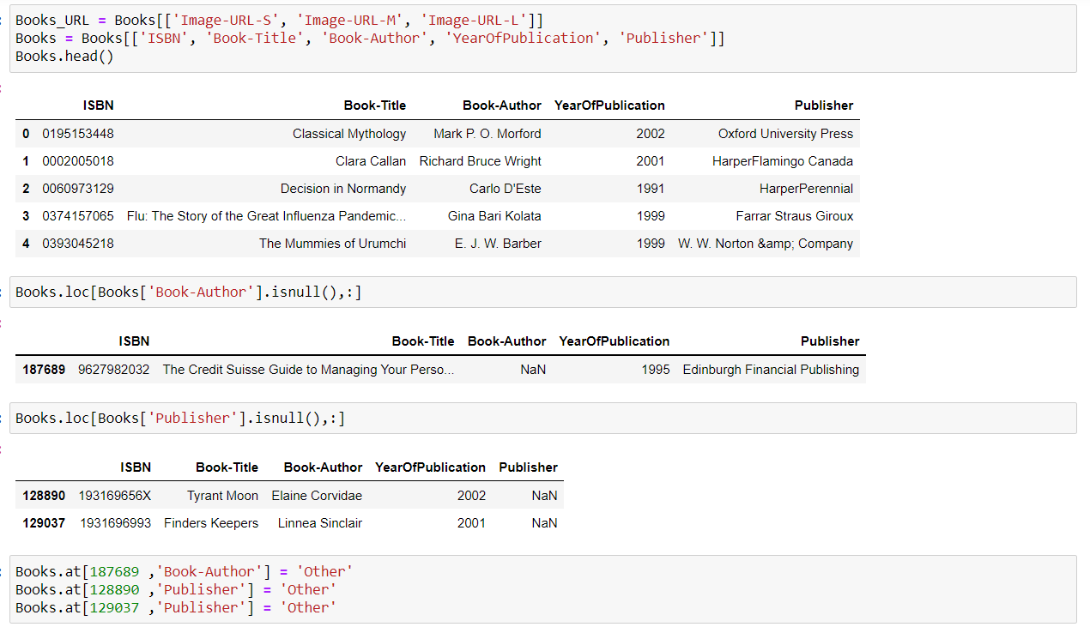
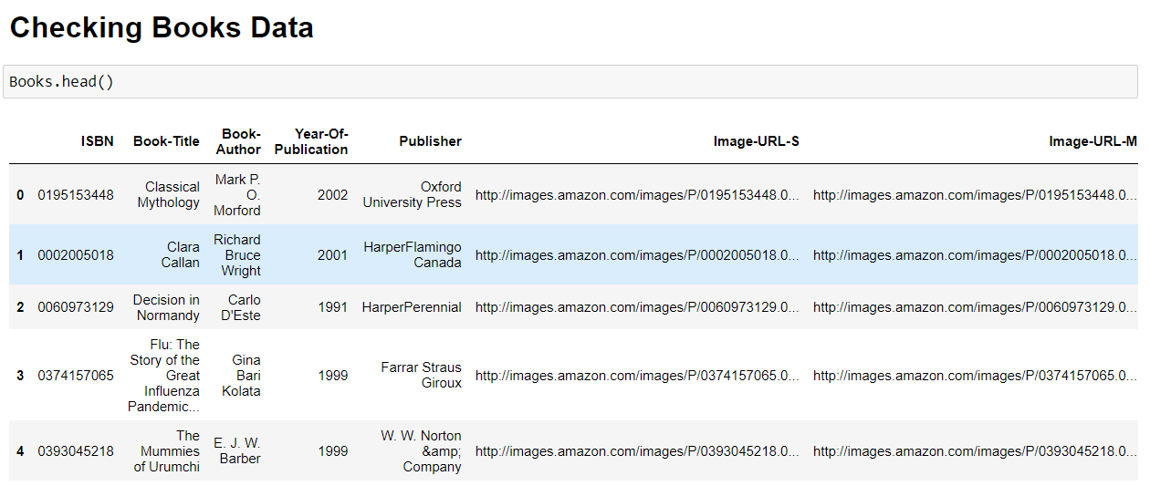
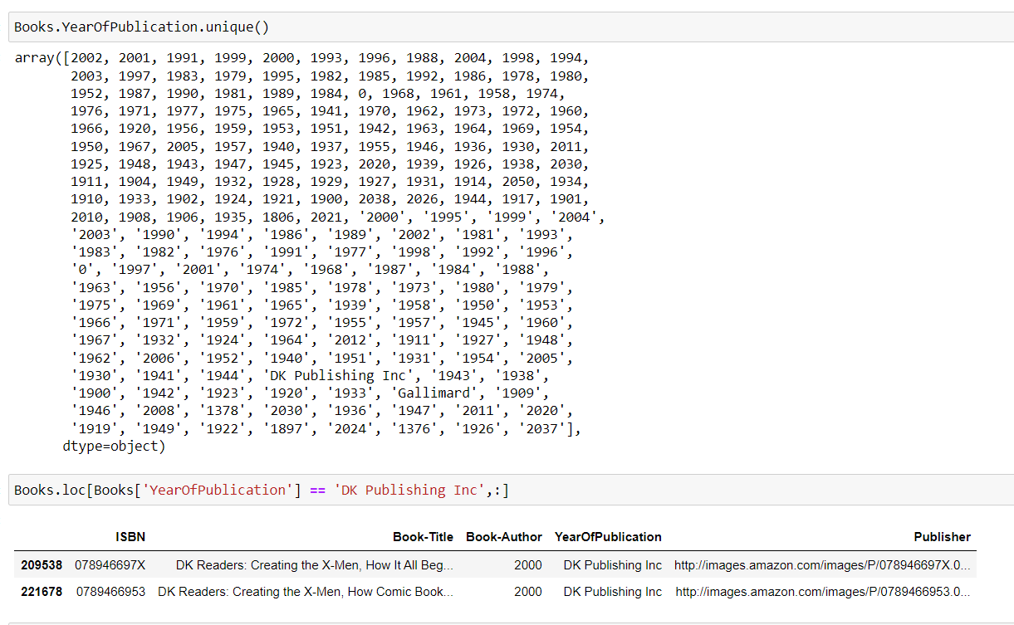
Exploratory Data Analysis (EDA) & Visualization
BOOK DATA:

Slide 6
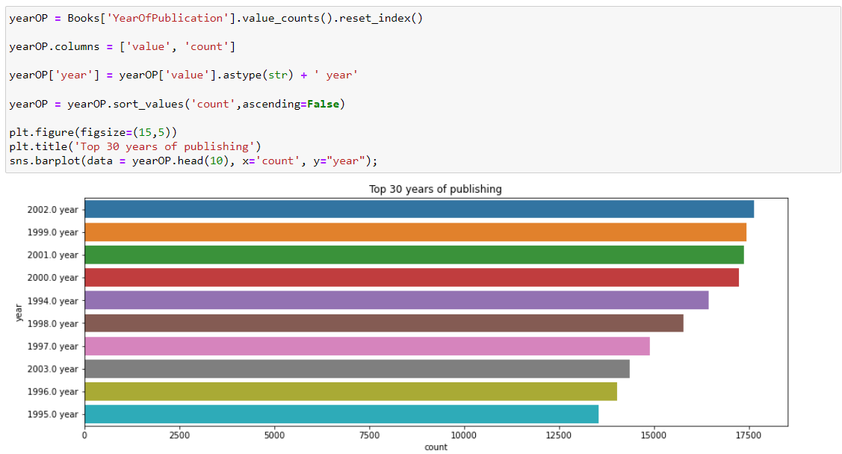
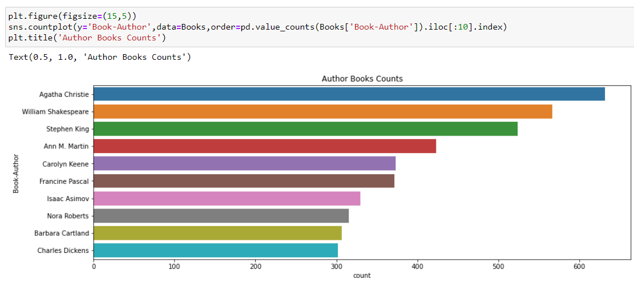
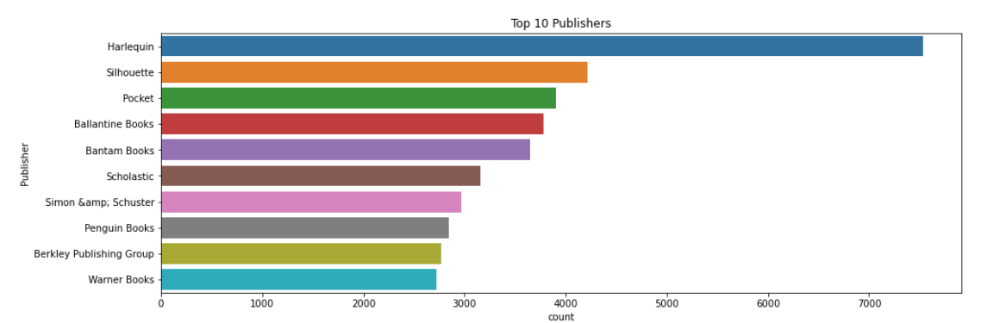

Slide 7
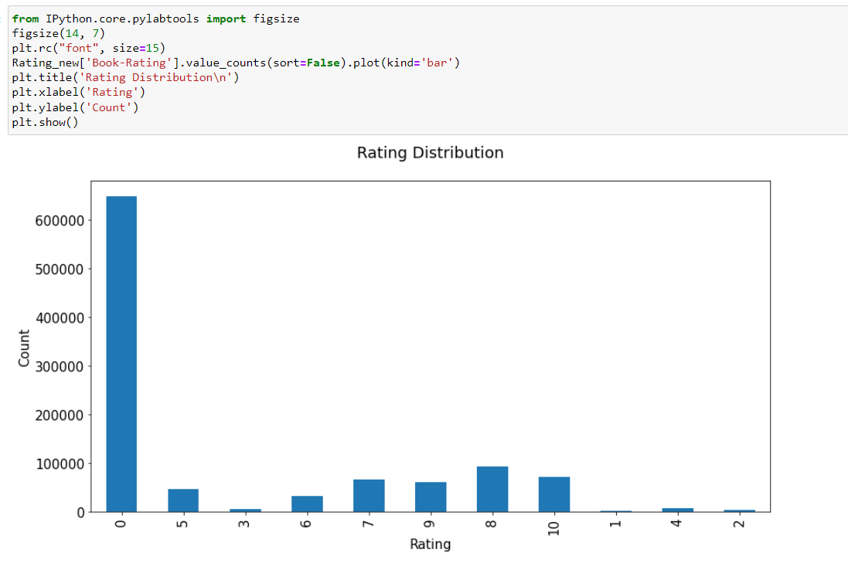
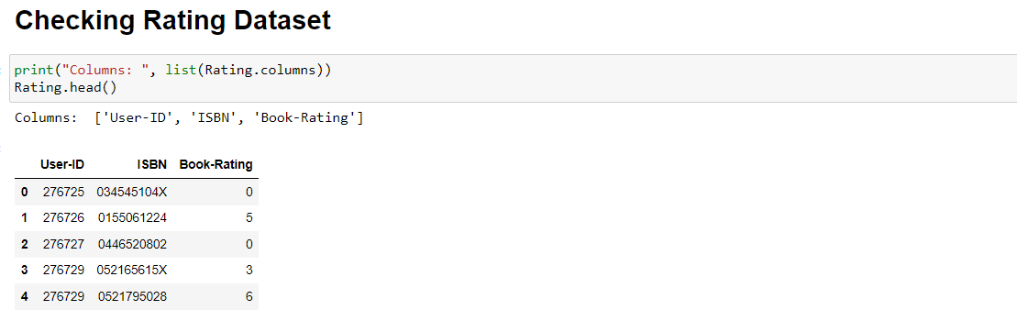
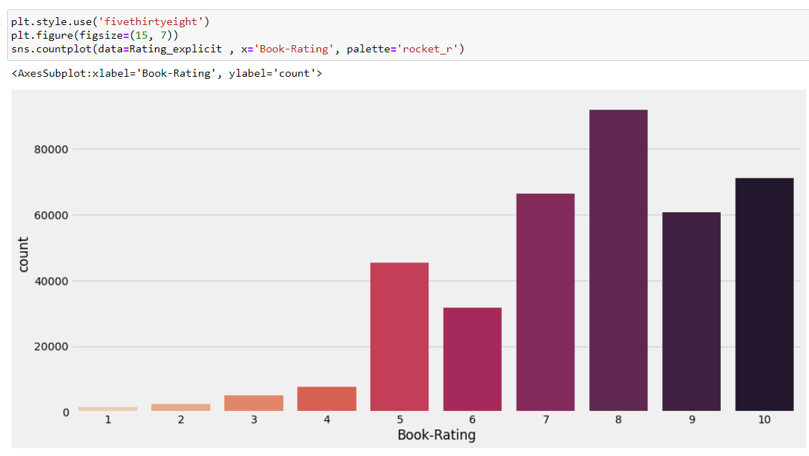
BOOK RATING DATASET:

Slide 8
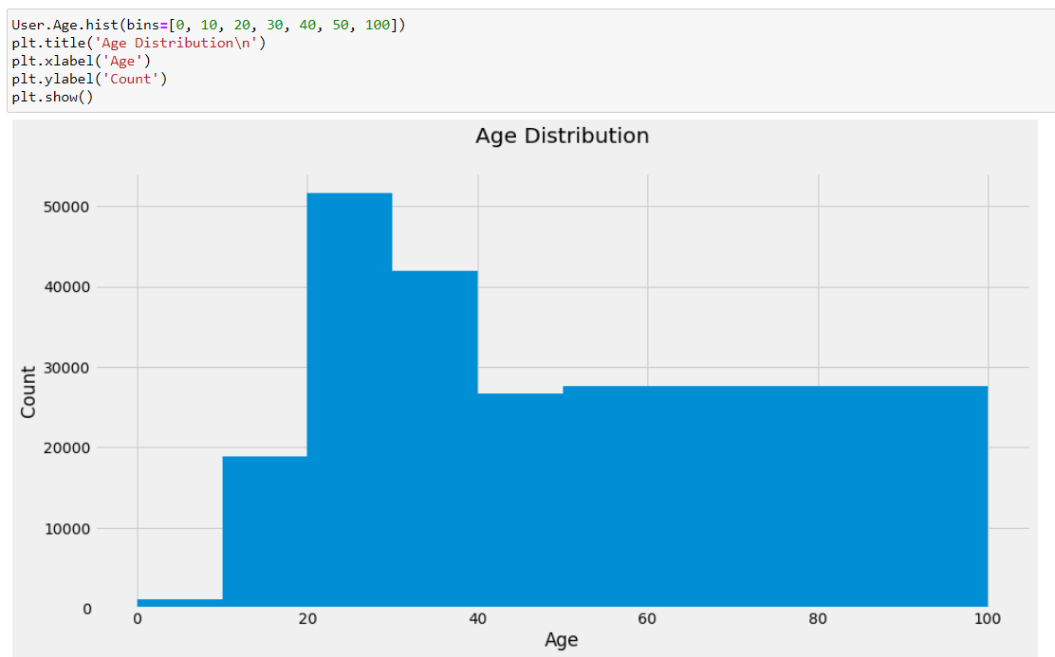
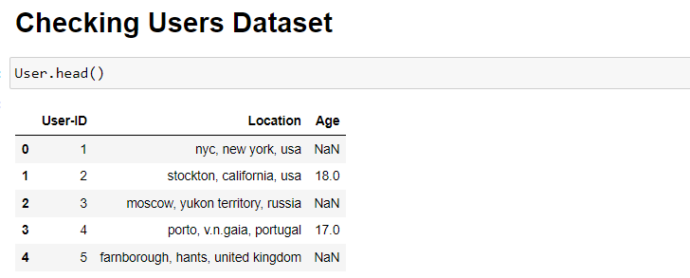
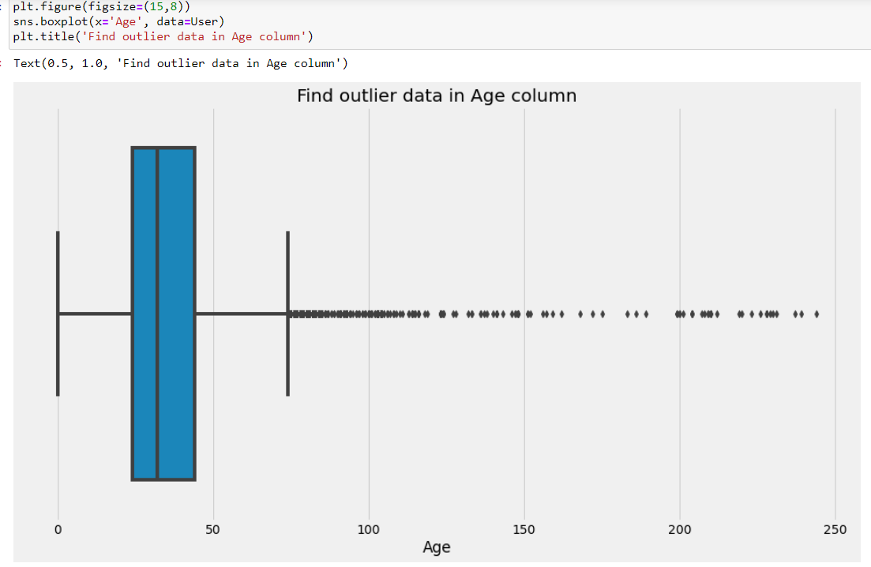
USERS DATASET :

Slide 9
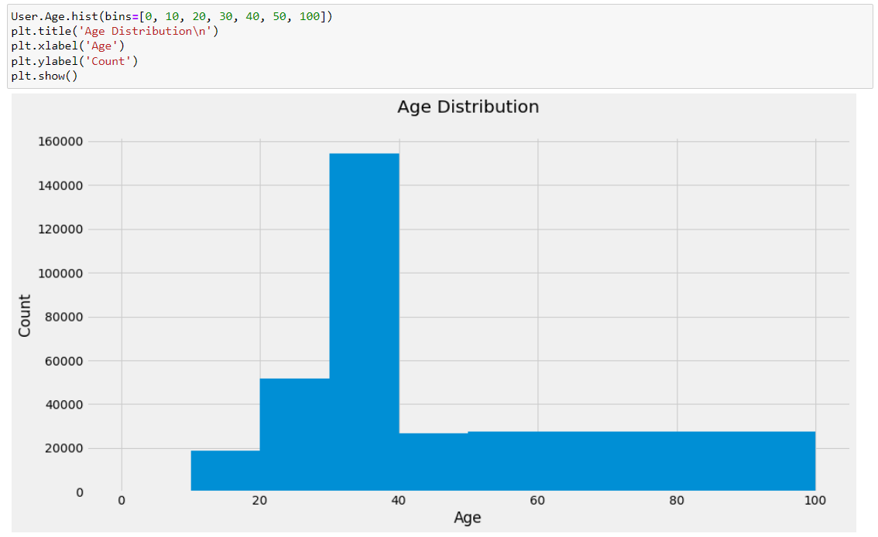

Slide 10
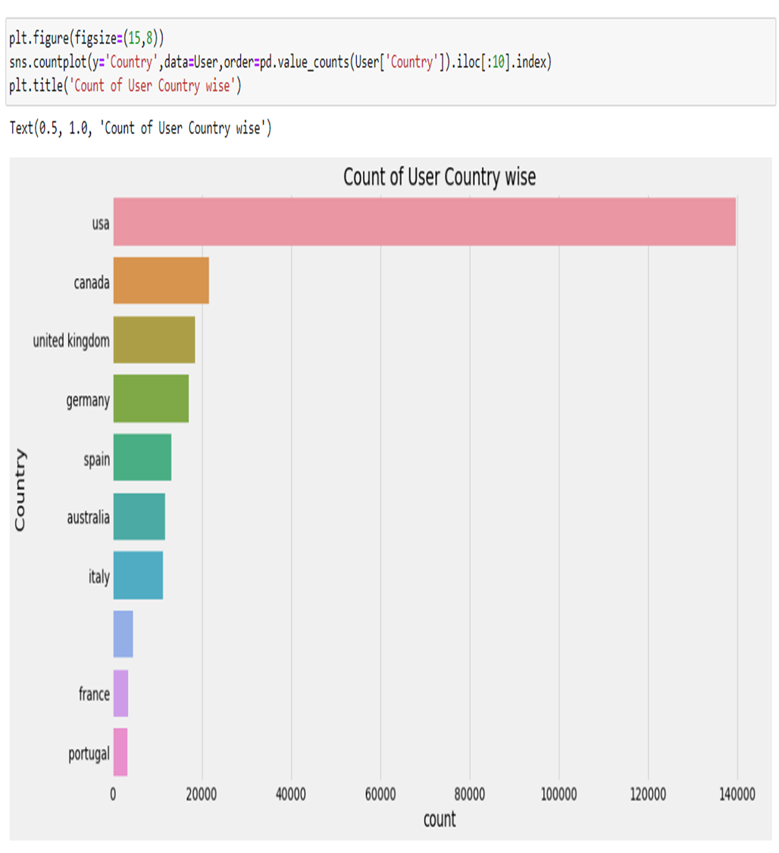
Countries With the Most Number of Book Counts

Slide 11
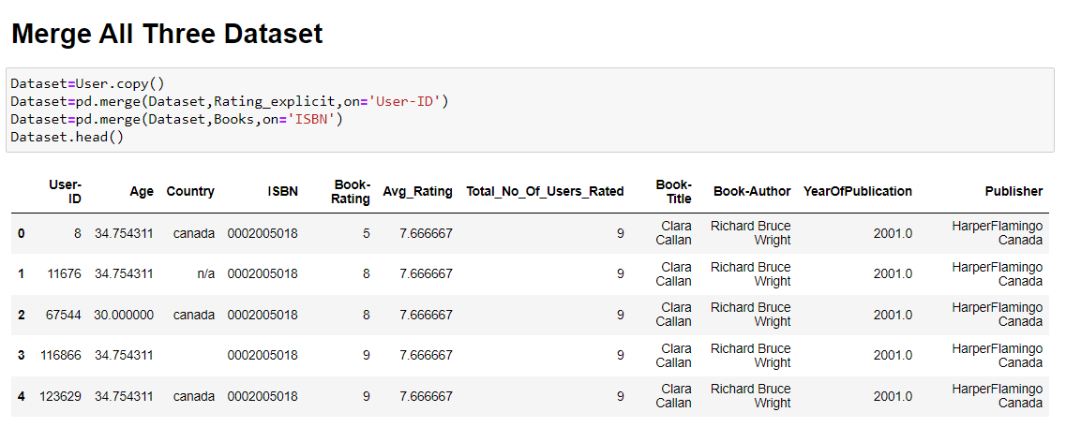
MERGING ALL THREE DATASET

Slide 12
MODEL BUILDING :
POPULARITY BASED RECOMMENDATION :
Book weighted average formula :
(WR)=[vR/(v+m)]+[mC/(v+m)]
Where as,
v is the number of votes for the books
m is the minimum votes required to be listed in the chart;
R is the average rating of the book; and
C is the mean vote across the whole report.

Slide 13
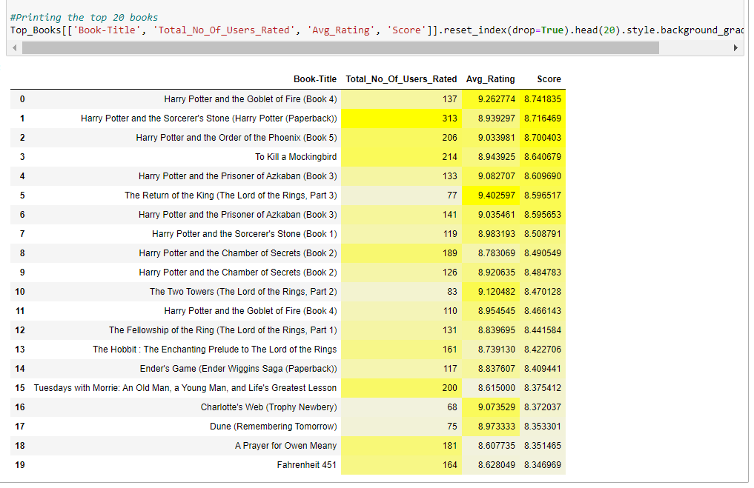

Slide 14
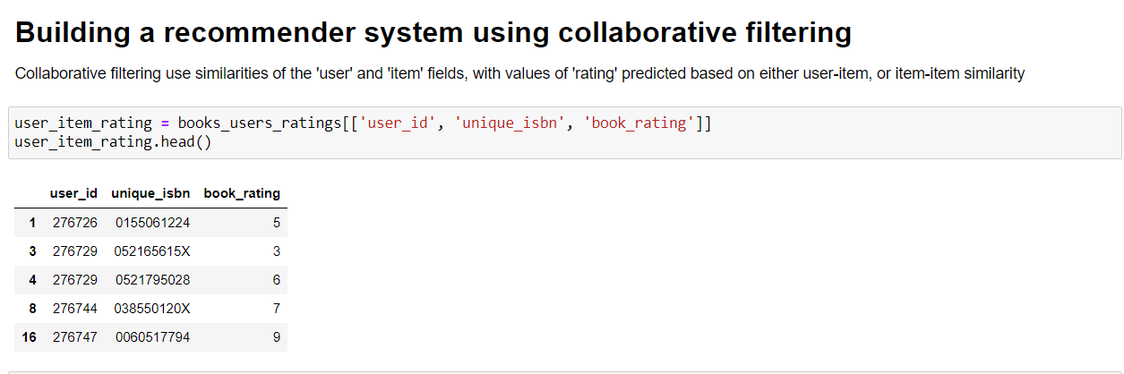
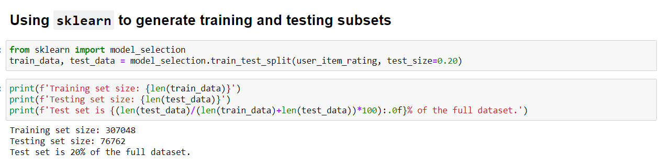
2. COLLABORATIVE FILTERING BASED RECOMMENDATION:
Collaborative filtering use similarities of the 'user' and 'item' fields, with values of 'rating' predicted based on item-item similarity
TRAINING AND TESTING SUBSET:

Slide 15
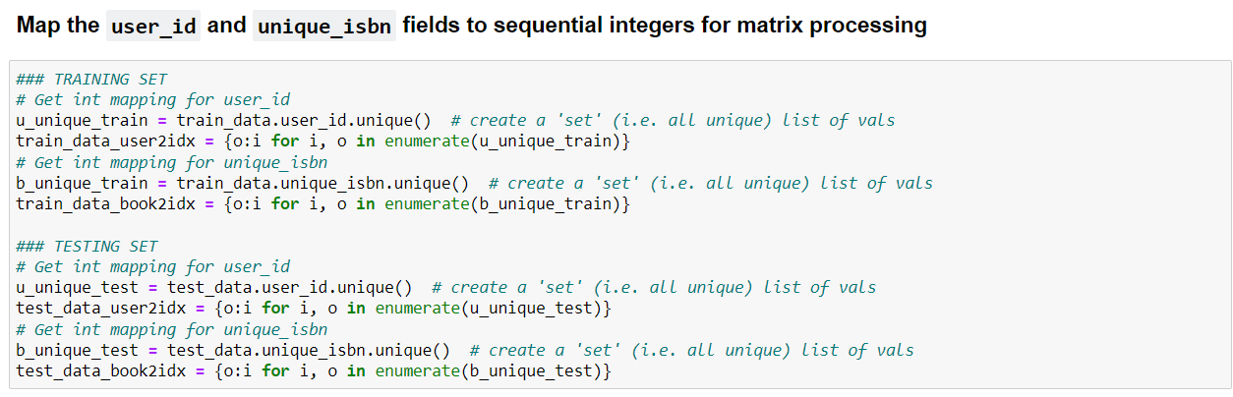
COSINE SIMILARITY WITH ‘PAIRWISE DISTANCE’ FUNCTION :

Slide 16
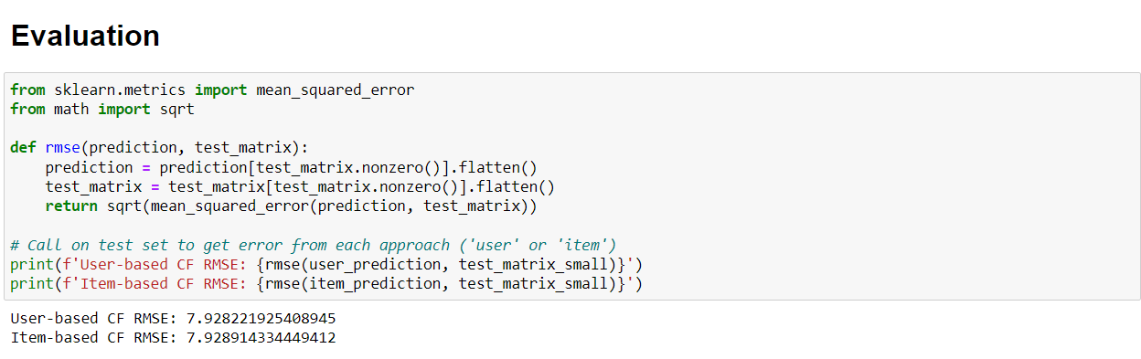
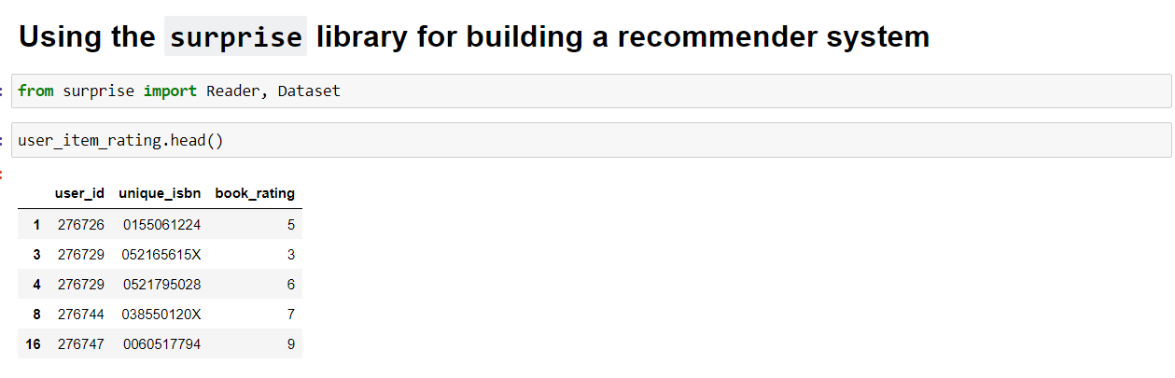
EVALUATION :
IMPORTING SURPRISE LIBRARY FOR BUILDING A RECOMMENDER SYSTEM:

Slide 17
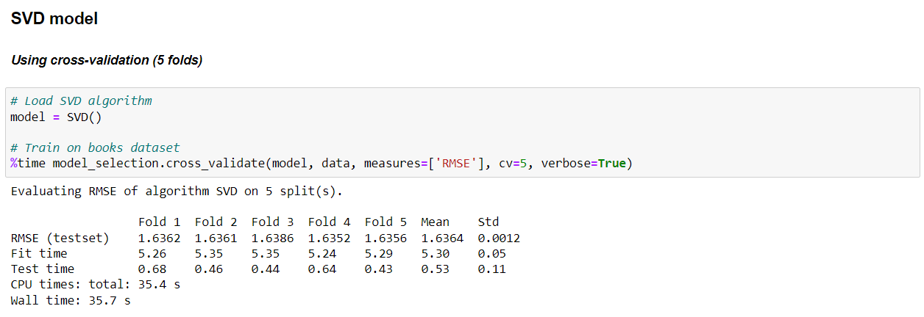
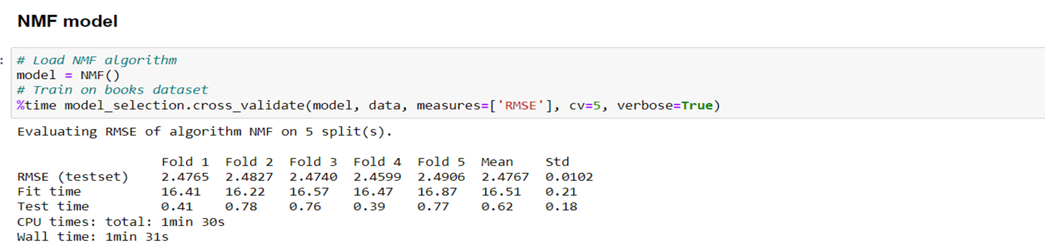
SVD MODEL :
NMF MODEL:

Slide 18
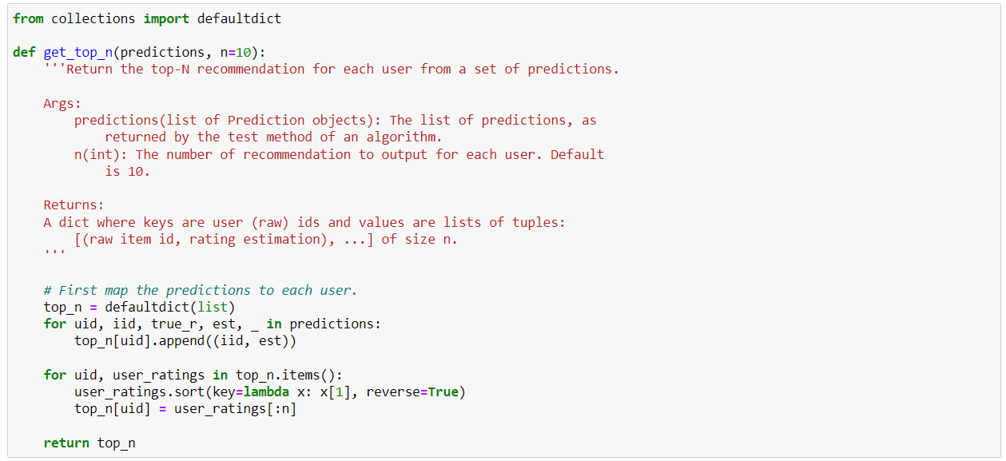
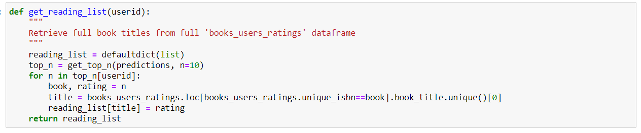
Model Building

Slide 19
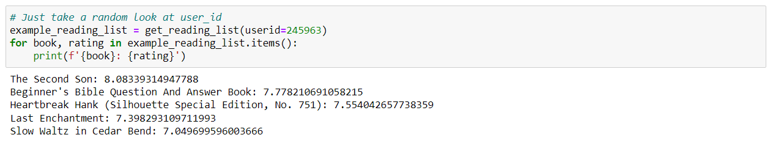
Testing Some Results

Slide 20
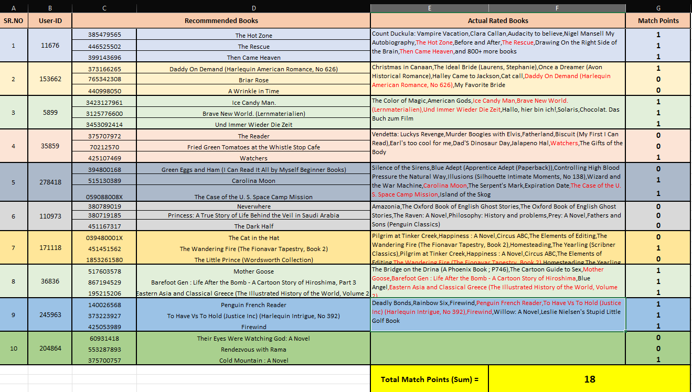
EVALUATION EXCEL FILE

Slide 21
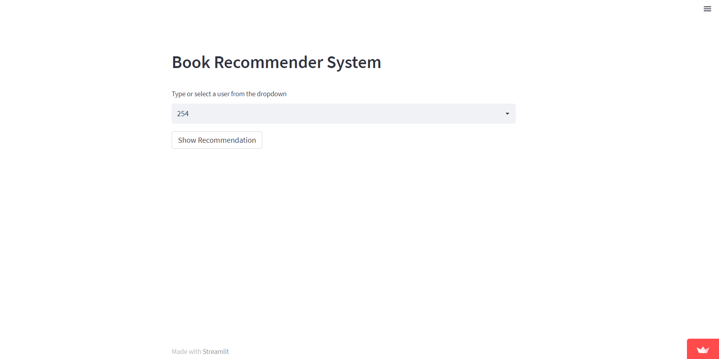
DEPLOYMENT USING STREAMLIT

Slide 22
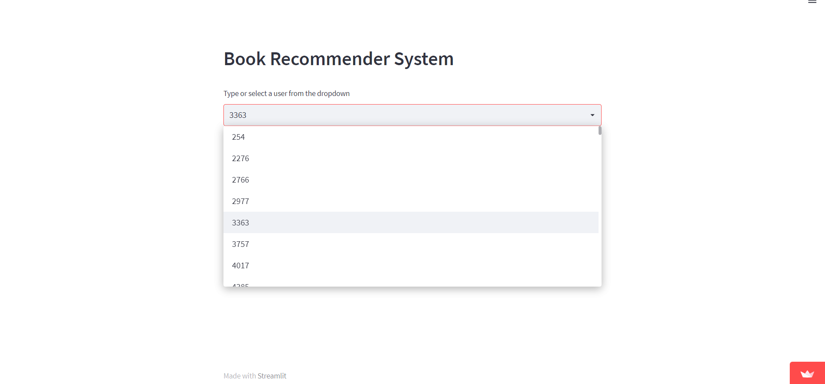
SELECT USER

Slide 23
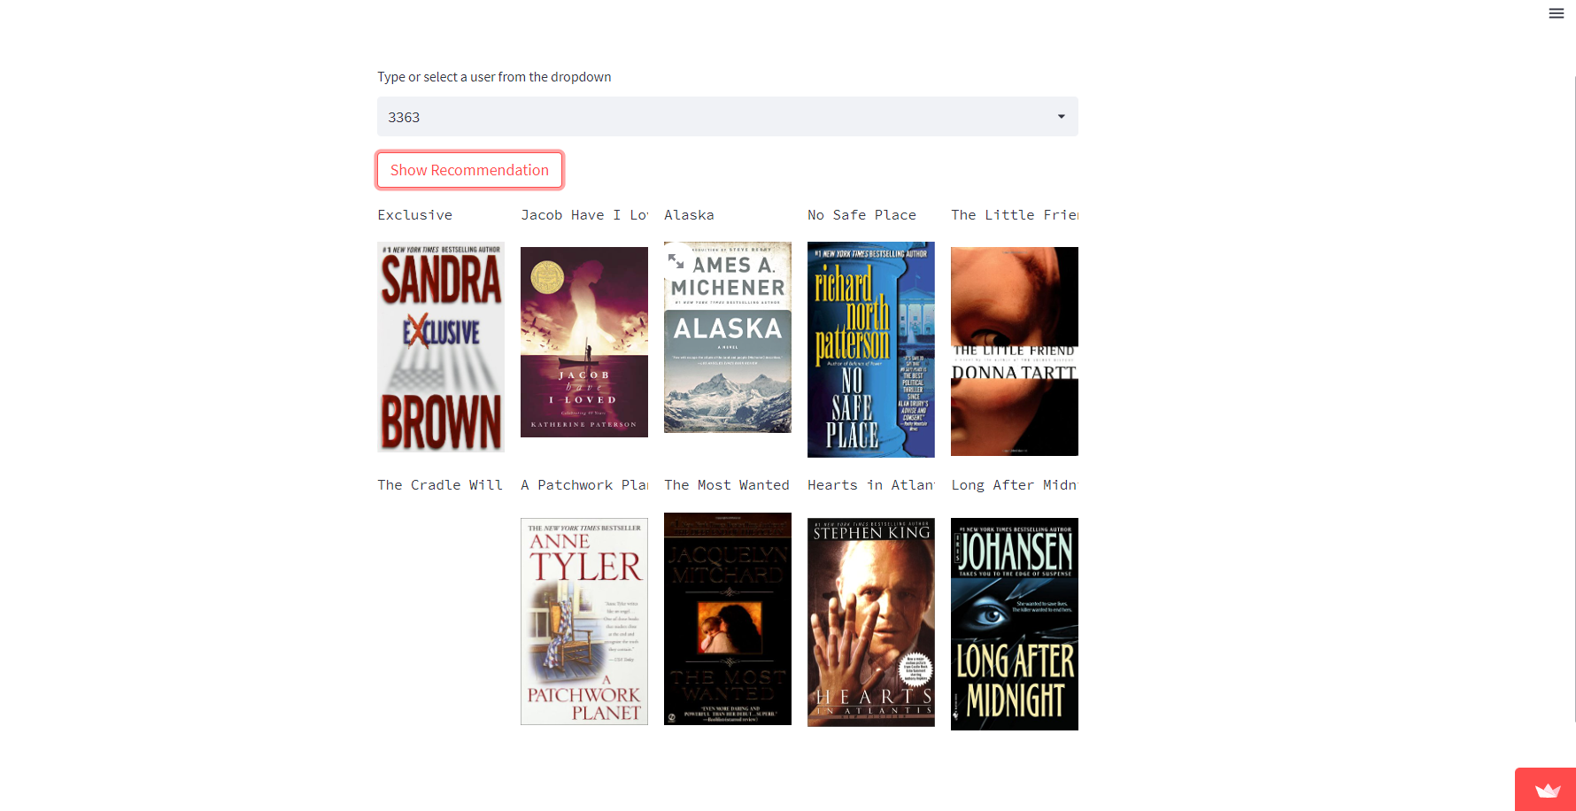
TOP 10 RECOMMENDED BOOKS

Slide 24
APP LINK
https://mahesh-renkuntla-book-recommendation-system-project--app-r7cvta.streamlitapp.com/
GitHub Links
https://github.com/mahesh-renkuntla/Book-Recommendation-system-Project-
https://github.com/AdityaRao09/Book-Recommendation.git
https://github.com/nikhillegend/Recommendation-System-Project
https://github.com/sobeeya/Project-Recommendation-Systems
https://github.com/Prajwal1508/Recommendation-System-Project-.git

Slide 25


